Slide 1


Panimalar Engineering College
Department of Computer Science And Engineering
Transformative Tour Planning with Dynamic Route Optimization
Team Members
Bangarru Srijesh M 211420104034
Barathan K 211420104035
Dhayanand G B 211420104062
Guide Name
Coordinator Name
Dr. N. Pughazendi
Dr. N. Pughazendi

Slide 2
ABSTRACT:
Tour planning is essential for enhancing the travel experience.
Ineffective planning may lead to time waste and cancellations.
The objective is to generate an optimized travel plan.
Utilizes data on the best time to visit attractions.
Incorporates information on local transportation and guides.
Considers data on climate changes, disasters, and seasonal tour visit.
Enhances the local journey with multiple destinations.

Slide 3
EXISTING SYSTEM:
Wide range of data on hotels and lodges
Allowing users to book rooms at hotels and lodges
Compiling detailed information about different destinations
Aggregating user reviews on various places
Providing transportation recommendations
Estimating approximate ticket prices for flights and trains
Assisting in basic tour planning based on user-selected places

Slide 4
PROPOSED SYSTEM:
Offering route recommendations for exploring the locale.
Utilizing RBM and big data for optimizing tour plans.
Ensuring Best time of attraction and seasonal journey for travelers.
Crafting tour plans based on a user's singular preference.
Best tour guide for devotional travelers.
Customization and modification on tour plans.
Ensuring a minimalist user experience for simplicity and ease of use.
Grouping travelers on same journey.

Slide 5
LITERATURE SURVEY:
Year | Title | Author | Description | Advantages | Disadvantages
2020 | Optimal Route Planning System for Logistics Vehicles Based on Artificial Intelligence | Fan-Hsun Tseng | The system utilizes Google Maps and its distance matrix to search for routes. The routes undergo a multilayer perception model and utilize Dijkstra’s algorithm for traffic condition simulation | It includes multiple stops and destination It includes a travel plan. | Focused only on traffic conditions. Applicable only for ecommerce.
2019 | Smart Tour Route Planning Algorithm based on Clustering Center Motive Iteration Search | Xiao Zhou, Mingzhan Su, Zhong Liu, De Zhang | It utilizes a clustering centre for temporary accommodation to build an optimal tourist sight-extracting algorithm. On the way, the shortest path is built between the clustering centre and the tourist sight. | It has a generated binary tree for optimal closed-loop structure. It can solve problems of common tour route planning. | It doesn’t utilise geolocation and maps. Only a one-way route is possible.
2011 | A Model of Intelligent Tourism Guide System | H.H. Owaied, H.A Farhan, N. AI- Hawamdeh, N. AI-Okialy | Model-based on the philosophical view of human behaviour as a tourism guide. It mimics the human tourism guide, through relationships between knowledge and role. | XRM used in this system advances the CRM It has GIS with a Dynamic database. | It only mimics human behaviour and doesn’t have a Guide for travel within places. GIS implementation is limited.
2021 | Research on Tourism Route Planning Based on Artificial Intelligence Technology | Maobin Ging | An AI-based wireless sensor travels route planning. Built on improved TSP and combines normal distributed random number (ND) and Genetic Algorithm (GA). Implements multi-target dynamic optimization. | The AI wireless sensor enhances the experience and satisfaction of tourists. It makes the work of scenic spots more efficient. | The cost of establishment and maintenance is high. It needs continuous optimization and training of rapid data.

Slide 6
LITERATURE SURVEY:
2013 | Personal Tour Planning Incorporating Standard Tour Routes and Tourist Satisfaction | Takashi Hasuike, Hideki Katagiri, Hiroe Tsubaki, Hiroshi Tsuda | Proposes a personal Tour planning based on Time Expanded Network. It uses the Pareto optimal solution which can be applied to soft computing algorithms. It incorporates general tour routes and tourist satisfaction. | An optimal tour rote is generated. Tourists obtain time schedule with the best plan of standard tour routes | Only focus on schedule rather than the features of the places. Doesn’t include traffic analysis and other route constraints.
2020 | Multi-Task Travel Route Planning with a Flexible Deep Learning Framework | Feiran Huang, Jie Xu, Jian Weng | This framework integrates rich auxiliary information for more effective planning. It has a heterogeneous network for POI and an attention-based deep model integrating auxiliary information. With the beam search algorithm, multiple feasible routes are calculated. | It has a beam search algorithm which enhances the route calculation. POI patterns are generated which improves the overall journey. | The deep model needs convolutional networks to represent node features. Feature extraction is missing in this model.
2014 | Transport Route Planning for Mobile Tour Applications | Shou-Chih Lo, Fu-Chiang Huang, Chien-Chung Wang | This system showcases an efficient scan-based algorithm which arranges by considering route smoothness. A distributed shortest-path algorithm is provided to meet the time-changing traffic data. | It enhances mobile tourism with a scan-based approach. It also manages the real-time traffic data and derives an optimal shortest path. | It only works on two visiting points and doesn’t support multiple points. Focus only on route planning rather than tourism.
2018 | Parallel Hyper-Heuristic Algorithm for Multi-Objective Route Planning in a Smart City | Yuan Yao, Zhe Peng, Bin Xiao | This framework has low-level heuristics to generate new routes. It adopts reinforcement learning to accelerate searching speed. | It provides functionality higher than the MOEA for providing solutions to the MOOP. | It is tested only in cities. It doesn’t have a heuristic tour guide system.

Slide 7
IMPLEMENTATION ENVIRONMENT:
Software:
Operating System: Windows 11
IDE: Visual Studio Code
VS Code Plugins: Flutter, Dart, Jupyter
Framework: Flutter Framework
Emulator: Android Emulator
Notebook: Google Colab
Map API: Google Maps API
Backend: Firebase
Hardware:
Processor: i5 6th gen or higher/ Ryzen 5 1600 or higher
Graphics: Integrated Graphics or any External Graphics
RAM: 8 GB or higher
Hard Disk: 10GB for installation
Proper Internet Connectivity

Slide 8
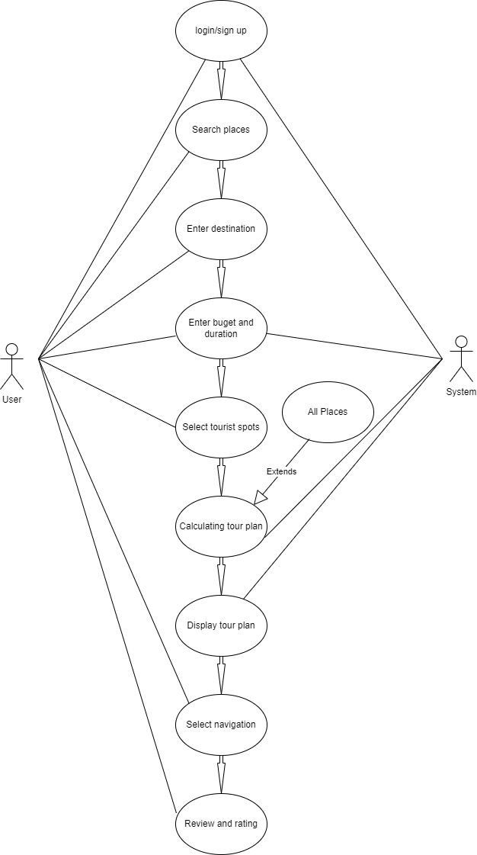
SYSTEM DESIGN
USE CASE DIAGRAM

Slide 9
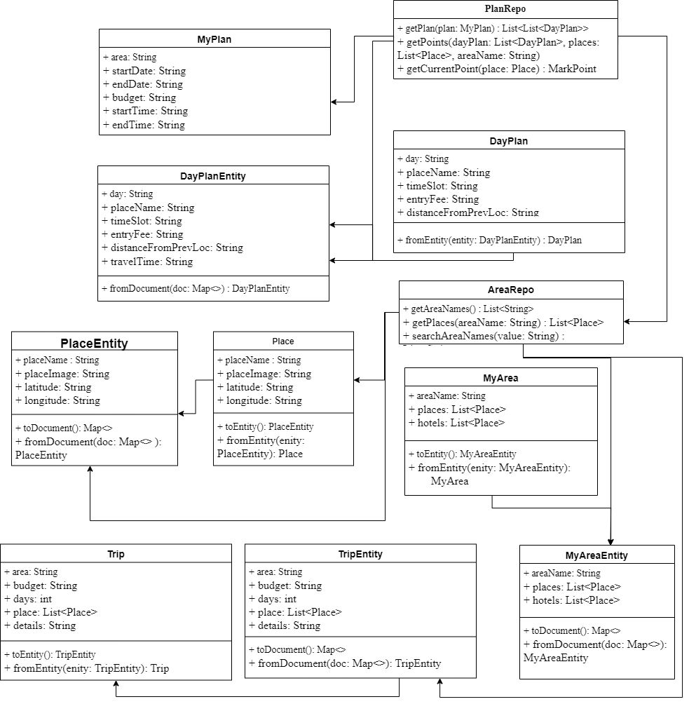
SYSTEM DESIGN
CLASS DIAGRAM

Slide 10
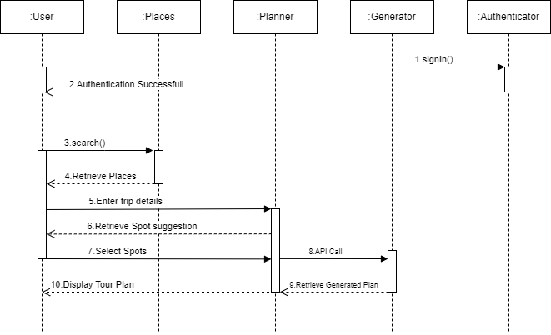
SYSTEM DESIGN
SEQUENCE DIAGRAM

Slide 11
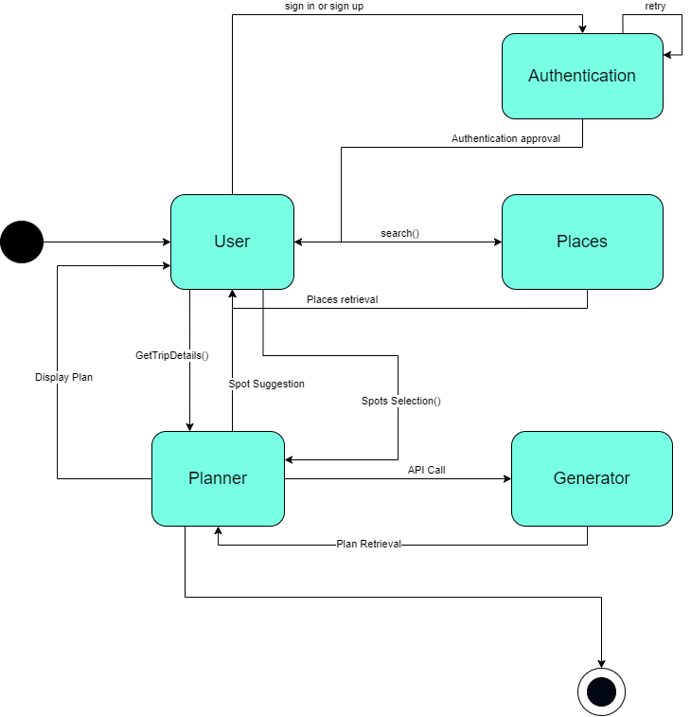
SYSTEM DESIGN
COLLABORATION DIAGRAM

Slide 12
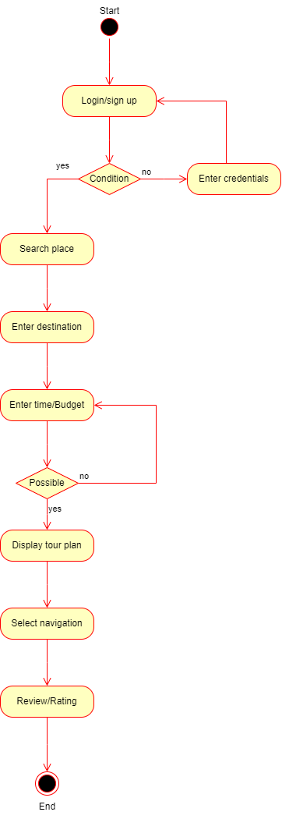
SYSTEM DESIGN
ACTIVITY DIAGRAM

Slide 13
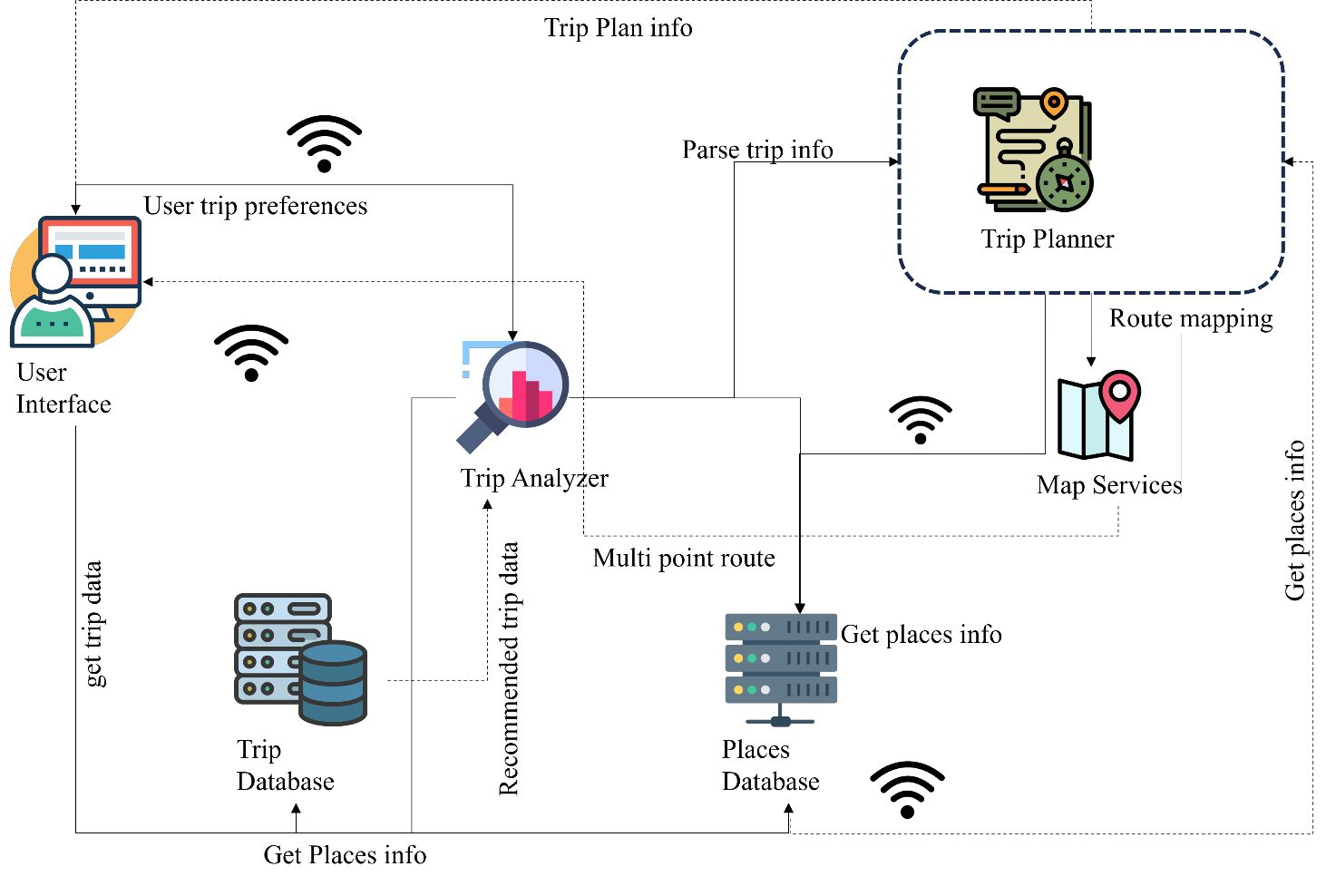
SYSTEM ARCHITECTURE:

Slide 14
MODULES:
CUSTOM MODEL:
Collaborative Filtering technique used in recommendation systems.
Factorizes a user-item interaction matrix into lower-dimensional matrices for users and items.
ALS is an iterative optimization algorithm.
Runs in parallel for scalability and handles sparse ratings data well.
Applied to hotel data with user ratings.
Trained with varying latent factor dimensions (ranks of 4, 8, and 12).
Parameters include maximum iterations (5), regularization parameter (0.01), and user/hotel IDs.

Slide 15
MODULES:
APPLICATION MODULE
UI LAYER:
Authentication screens: SignUpScreen and SignInScreen.
Home Screen: Displays places and includes a search functionality.
Trip Planning Screens: TripDetailsScreen, TouristSpotsScreen, and TourPlanScreen.
Widgets communicate with the domain layer for business logic and data retrieval.
DOMAIN LAYER:
Manages user authentication with AuthManager.
Tour planning logic handled by TripPlanner.
TouristSpotSelector suggests spots based on user preferences.
TourPlanGenerator generates a tour plan with routes.

Slide 16
MODULES:
DATA LAYER:
User Repository manages user-related data.
Place Repository handles information about different places.
Tourist Spot Repository fetches data about tourist spots.
Tour Plan Repository manages storage and retrieval of tour plans.
GMAPS API AND FIREBASE:
Distance matrix API and routes API for location, places and multi stops routing.
Components form a robust ecosystem for developing location-aware applications.
Google Maps integration enhances visualization of geographic information.
Firebase stores and manages real-time data.

Slide 17
MODULES:
DATA LAYER:
User Repository manages user-related data.
Place Repository handles information about different places.
Tourist Spot Repository fetches data about tourist spots.
Tour Plan Repository manages storage and retrieval of tour plans.
GMAPS API AND FIREBASE:
Distance matrix API and routes API for location, places and multi stops routing.
Components form a robust ecosystem for developing location-aware applications.
Google Maps integration enhances visualization of geographic information.
Firebase stores and manages real-time data.

Slide 18
Results:
RBM algorithm powers tour app, tailoring plans for users.
Iterative learning refines recommendations for optimal travel experiences.
RBM delivers personalized tour plans, boosting satisfaction and engagement.
Unique approach sets app apart, creating memorable travel experiences.
Scalable application accommodates growing user base and data volume.

Slide 19
Conclusion:
RBM integration advances personalized tour planning in our application.
Our system utilizes RBM to generate optimal tour plans.
RBM's iterative learning analyzes data for tailored recommendations.
Enhancing satisfaction, optimizing resources, promoting sustainable travel.
RBM enables continuous improvement, adaptation based on user feedback.

Slide 20
Appendices:
SDG Goals
SDG 8: Decent Work and Economic Growth : Contributes to economic growth by creating employment opportunities, and contributes to economic growth by stimulating local economies in tourist destinations.
SDG 9: Industry, Innovation, and Infrastructure: Accommodation booking, and destination exploration, thereby contributing to the development of innovative infrastructure within the tourism industry.
SDG 11: Sustainable Cities and Communities: Encourages sustainable mobility and helps alleviate the environmental impact of tourism on urban areas, contributing to the development of sustainable cities and communities.

Slide 21

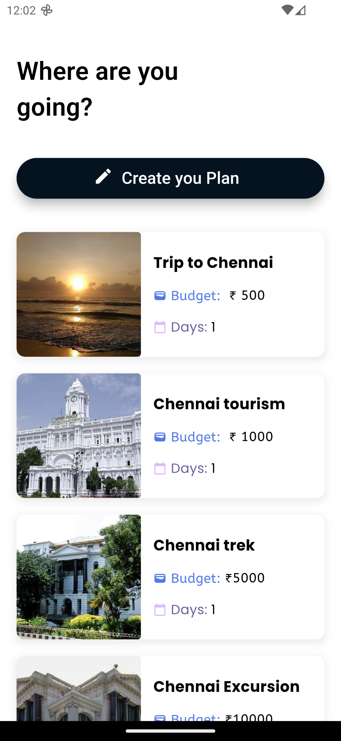
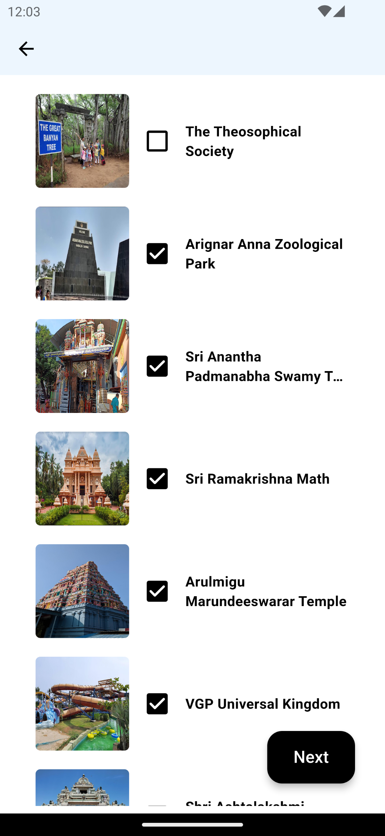
Appendices:

Slide 22
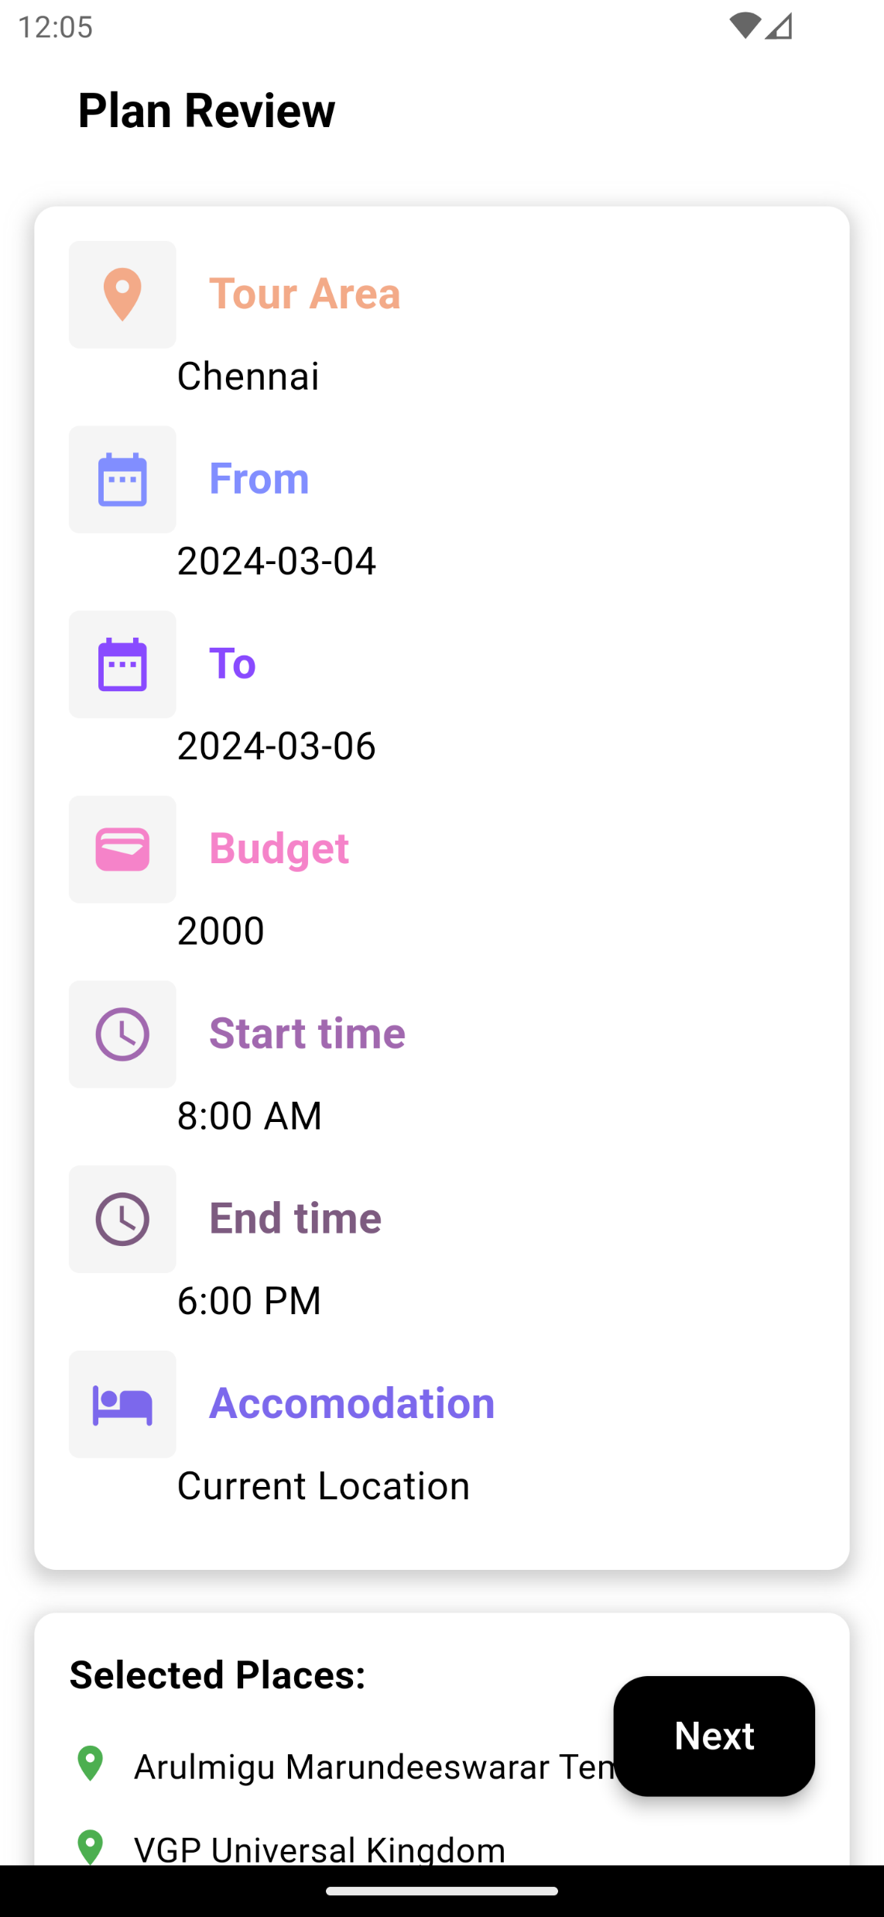
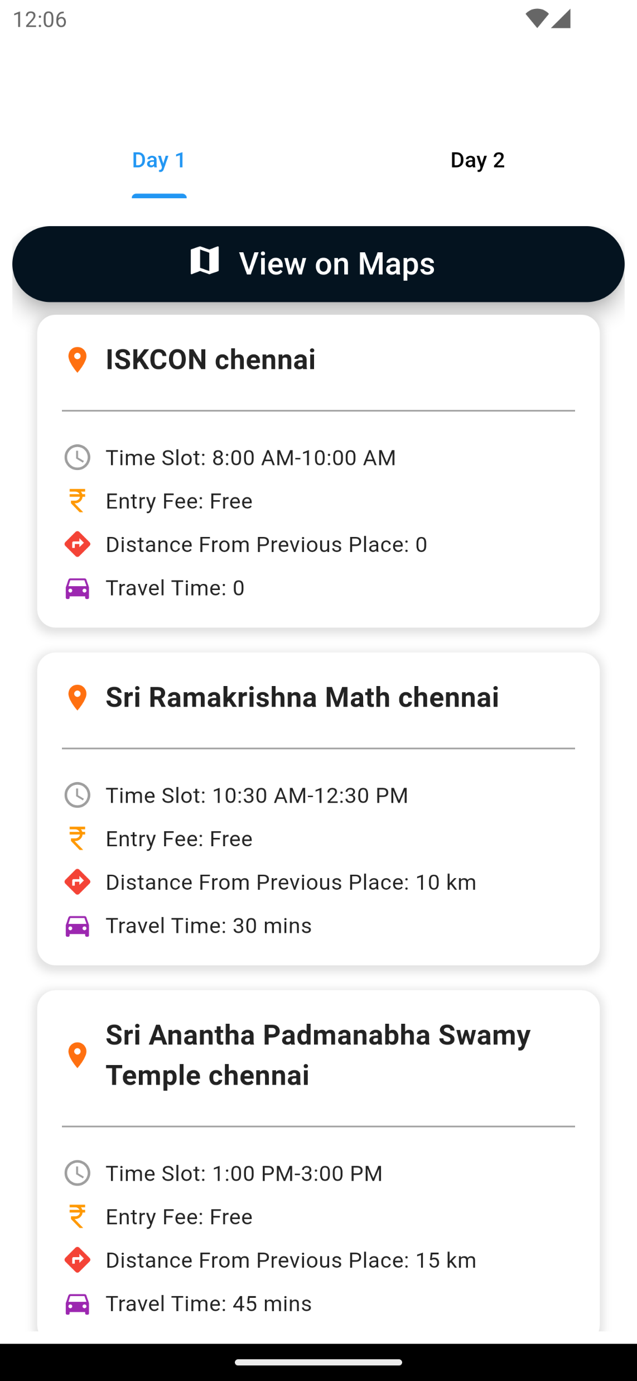
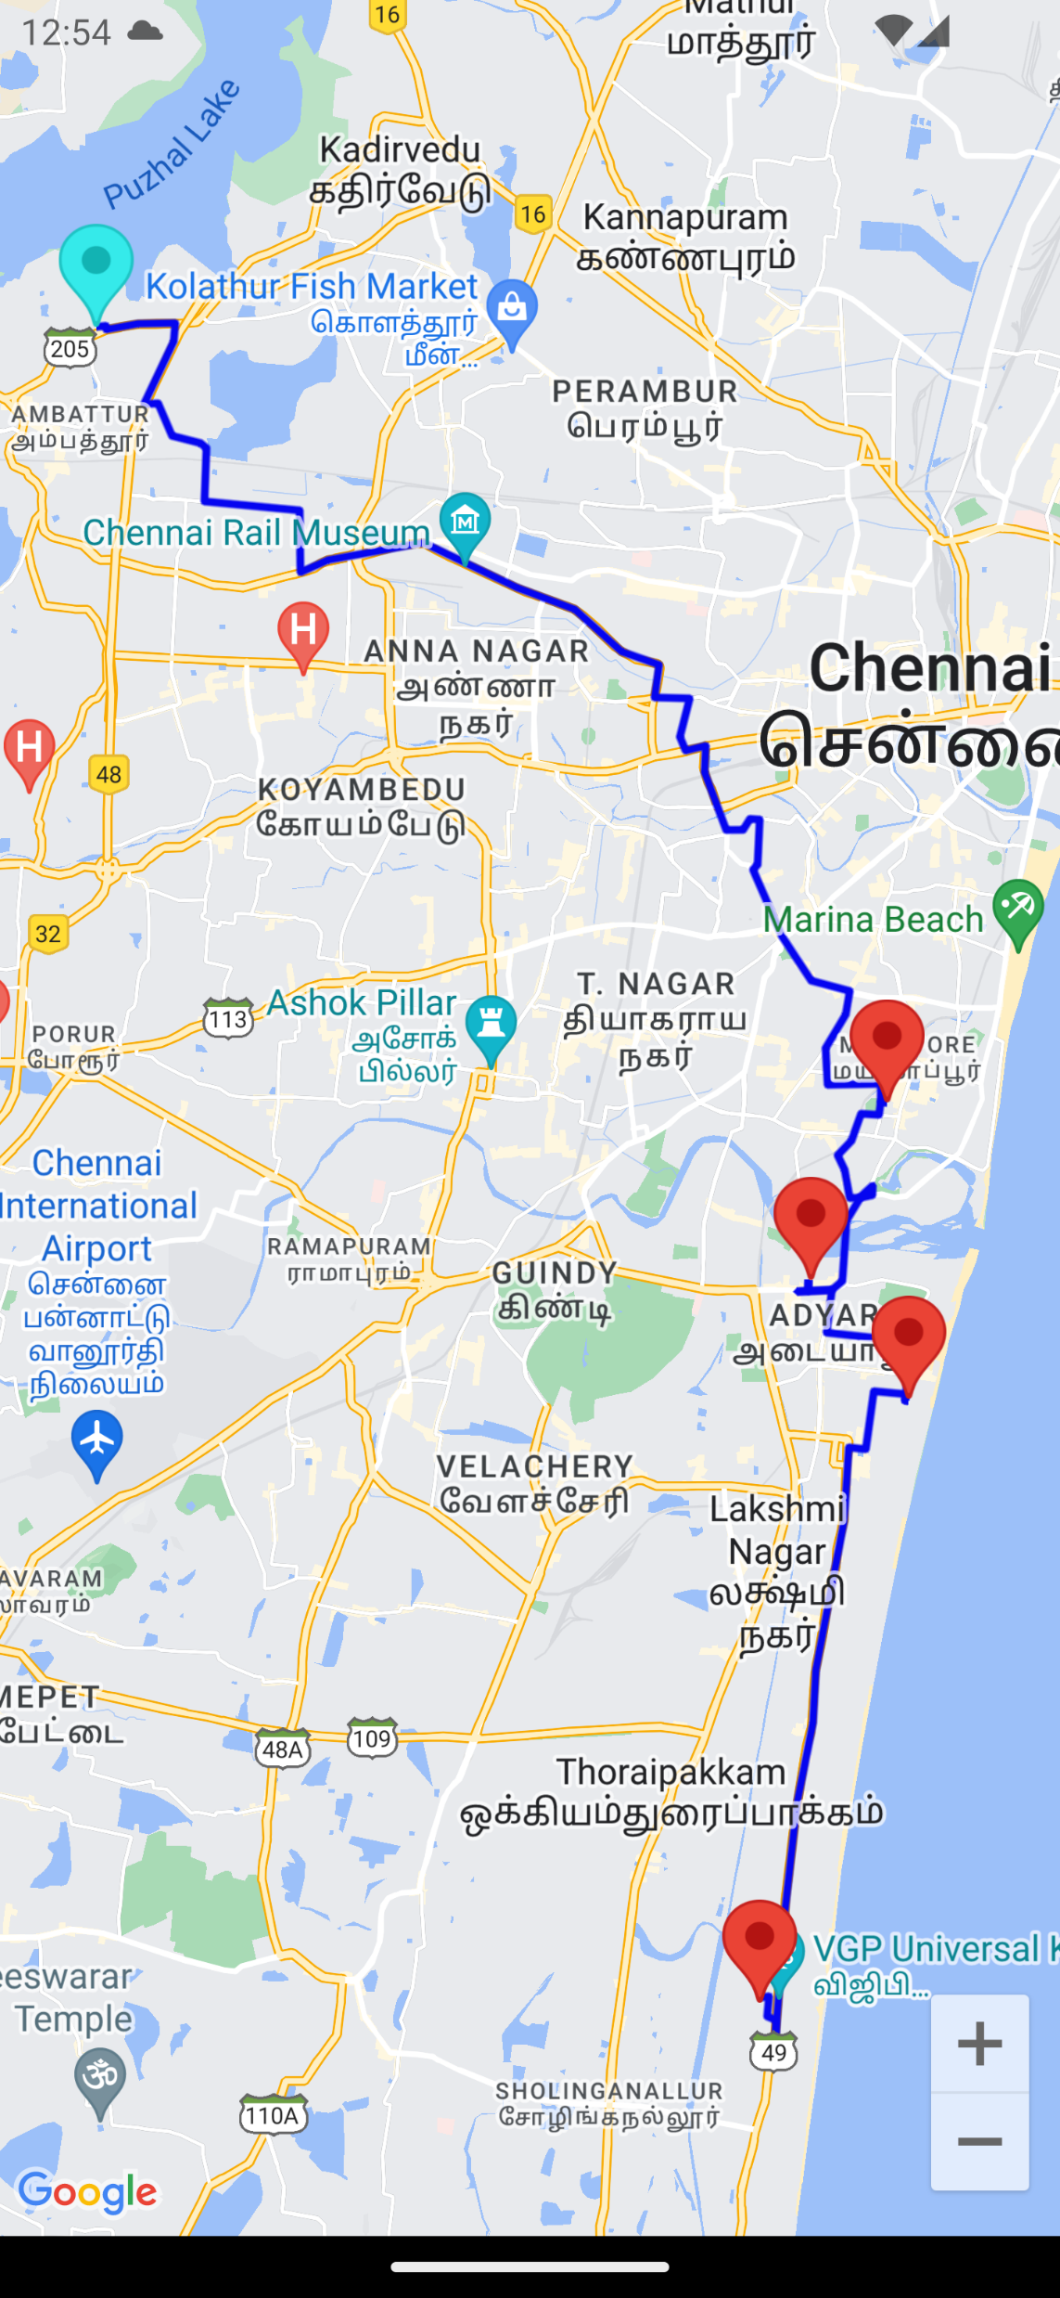
Appendices:

Slide 23
References:
[1] Fan-Hsun Tseng (2020). "Optimal Route Planning System for Logistics Vehicles Based on Artificial Intelligence."
[2] Xiao Zhou, Mingzhan Su, Zhong Liu, De Zhang (2019). "Smart Tour Route Planning Algorithm based on Clustering Center Motive Iteration Search."
[3] H.H. Owaied, H.A Farhan, N. AI- Hawamdeh, N. AI-Okialy (2011). "A Model of Intelligent Tourism Guide System."
[4] Maobin Ding, Volume 2021, Article ID 2227798, 7 pages
https://doi.org/10.1155/2021/2227798 "Research on Tourism Route Planning Based on Artificial Intelligence Technology."
[5] Takashi Hasuike, Hideki Katagiri, Hiroe Tsubaki, Hiroshi Tsuda (2013). "Personal Tour Planning Incorporating Standard Tour Routes and Tourist Satisfaction."
[6] Feiran Huang, Jie Xu, Jian Weng (2020). "Multi-Task Travel Route Planning with a Flexible Deep Learning Framework."

Slide 24
References:
[7] Shou-Chih Lo, Fu-Chiang Huang, Chien-Chung Wang (2014). "Transport Route Planning for Mobile Tour Applications."
[8] Yuan Yao, Zhe Peng, Bin Xiao (2018). "Parallel Hyper-Heuristic Algorithm for Multi-Objective Route Planning in a Smart City."
[9] Kewad Rathod, Vinay Govekar, Mayuri Gaikwad, Ichhanshu Jaiswal, JETIR May 2021, Volume 8, Issue 5, “AI – Based Tourist Guide.”
[10] Kai Wang, Xinping Yan, Yupeng Yuan, Xiali Jiang, Gabriel Lodewijks, Rudy R. Negenborn, 2017 4th International Conference on Transportation Information and Safety (ICTIS), August 8-10, 2017, Banff, Canada, “ Study on Route Division for Ship Energy Efficiency Optimization Based on Big Environment Data.”
[11] Wen Ouyang, Chang Wu Yu, Pei-Ju Huang, Huai-Tse Chang, Sixth International Conference on Future Generation Communication Technologies (FGCT 2017), “ Non-Commutative path planning for tours with diversified attractions.”

